Slide 1

Project Pitch
Group 61

Slide 2
Team
Name | Student number | Email
Ties Schasfoort | 2775596 | t.j.b.schasfoort@student.vu.nl
Tomas Busa | 2763572 | t.busa@student.vu.nl
Michal Vladimír Lupták | 2763843 | m.v.luptak@student.vu.nl
Samuel Sameliak | 2763687 | s.sameliak@student.vu.nl

Slide 3
Overview
Our project is aimed at developing a software solution dedicated to language learning. It will encompass the essential functionalities necessary for efficient language acquisition. Additionally, we plan to integrate a suite of features designed to gamify the learning experience, thereby making it more engaging for users. Following slides will more deeply embark on:
Basic functionality
Main type of users
Customization/Extensions
Features

Slide 4
Basic functionality
Our software implementation will have a simple GUI, that will be used to navigate the user throughout the application and enhance their learning experience
Onboarding users and determining their starting level
Creating/Modifying/Removing levels
Importing/Exporting levels
Gamified way of learning, rewarding users for persistence
Overview of users learning statistics

Slide 5
Users
Based on statistics indicating that most of the users are aged between 18 to 34 years old, our GUI will be therefore tailored to appeal to younger users
As the majority of users’ first language is English, our software implementation will use English as language of instruction
Given that the majority of users are from the United States of America, we will adhere to US grammar standards in our software implementation
These decisions were made after analysing data from: https://www.usesignhouse.com/blog/duolingo-stats

Slide 6
Customization/Extensions
Learning a language isn't just about acquiring new words and using them; it also involves adapting to the sound of the language. Therefore, we will implement a feature that allows users to listen to the words they have just learned
Learning a new language from the beginning might be unnecessary in case you already possess basic knowledge. To avoid this, we will implement a feature which will assess your knowledge before you start learning.

Slide 7
Feature 1
Name: Manage levels
Description:
Users should be able to create, update, and delete levels.
They can also perform these operations on individual flashcards and their accompanying solutions.
Champion: Ties Schasfoort
Notes:
In the champion field you put the name of the team member who is responsible for the modeling/implementation of the feature during the whole project (from assignment 1 to assignment 3).

Slide 8
Feature 2
Name: Learning Mode
Description: the user can start levels and progress across their corresponding flashcards on a step-by-step basis with gamification elements.
Champion: Michal V. Luptak
Notes:
In the champion field you put the name of the team member who is responsible for the modeling/implementation of the feature during the whole project (from assignment 1 to assignment 3).

Slide 9
Feature 3
Name: Persistence
Description:
Levels and flashcards will be persisted as JSON files
Exporting/Importing from a predefined folder will be possible
Champion: Tomas Busa
Notes:
In the champion field you put the name of the team member who is responsible for the modeling/implementation of the feature during the whole project (from assignment 1 to assignment 3).
Feature 1: manage levels
Feat 2: learning mode
Feat 3: persistence through JSON files
Feat 4: achievements, badges (with percentages?)
Maybe a leveling system with xp?

Slide 10
Feature 4
Name: Smart Review
Description:
An overview of completed achievements, tracking the users learning progress
Champion: Samuel Sameliak
Notes:
In the champion field you put the name of the team member who is responsible for the modeling/implementation of the feature during the whole project (from assignment 1 to assignment 3).
Feature 1: manage levels
Feat 2: learning mode
Feat 3: persistence through JSON files
Feat 4: achievements, badges (with percentages?)
Maybe a leveling system with xp?

Slide 11
Feature 5 (bonus)
Name: Play the pronunciation
Description: When learning a new language, the sound aspect is an important part. To make sure you know the pronunciation of the words you're learning, you can use a button to hear the pronunciation.
Champion: Michal Vladimír Lupták

Slide 12
Feature 6 (bonus)
Name: User onboarding
Description:
When users start their learning journey, it is important to understand their level of proficiency in a given language. Not all users start with the same knowledge.
If a user embarks on lessons that are too advanced, the experience can become discouraging due to the lack of progress. Conversely, starting at a level that's too basic can lead to boredom and potentially result in the user discontinuing their use of our software.
This feature will prevent any of these two situations from happening, therefore once a user starts the app for the first time, there will be an initial assessment which will determine his starting level that reflects his proficiency level.
Champion: Tomas Busa
Notes:
In the champion field you put the name of the team member who is responsible for the modeling/implementation of the feature during the whole project (from assignment 1 to assignment 3).
Feature 1: manage levels
Feat 2: learning mode
Feat 3: persistence through JSON files
Feat 4: achievements, badges (with percentages?)

Slide 13
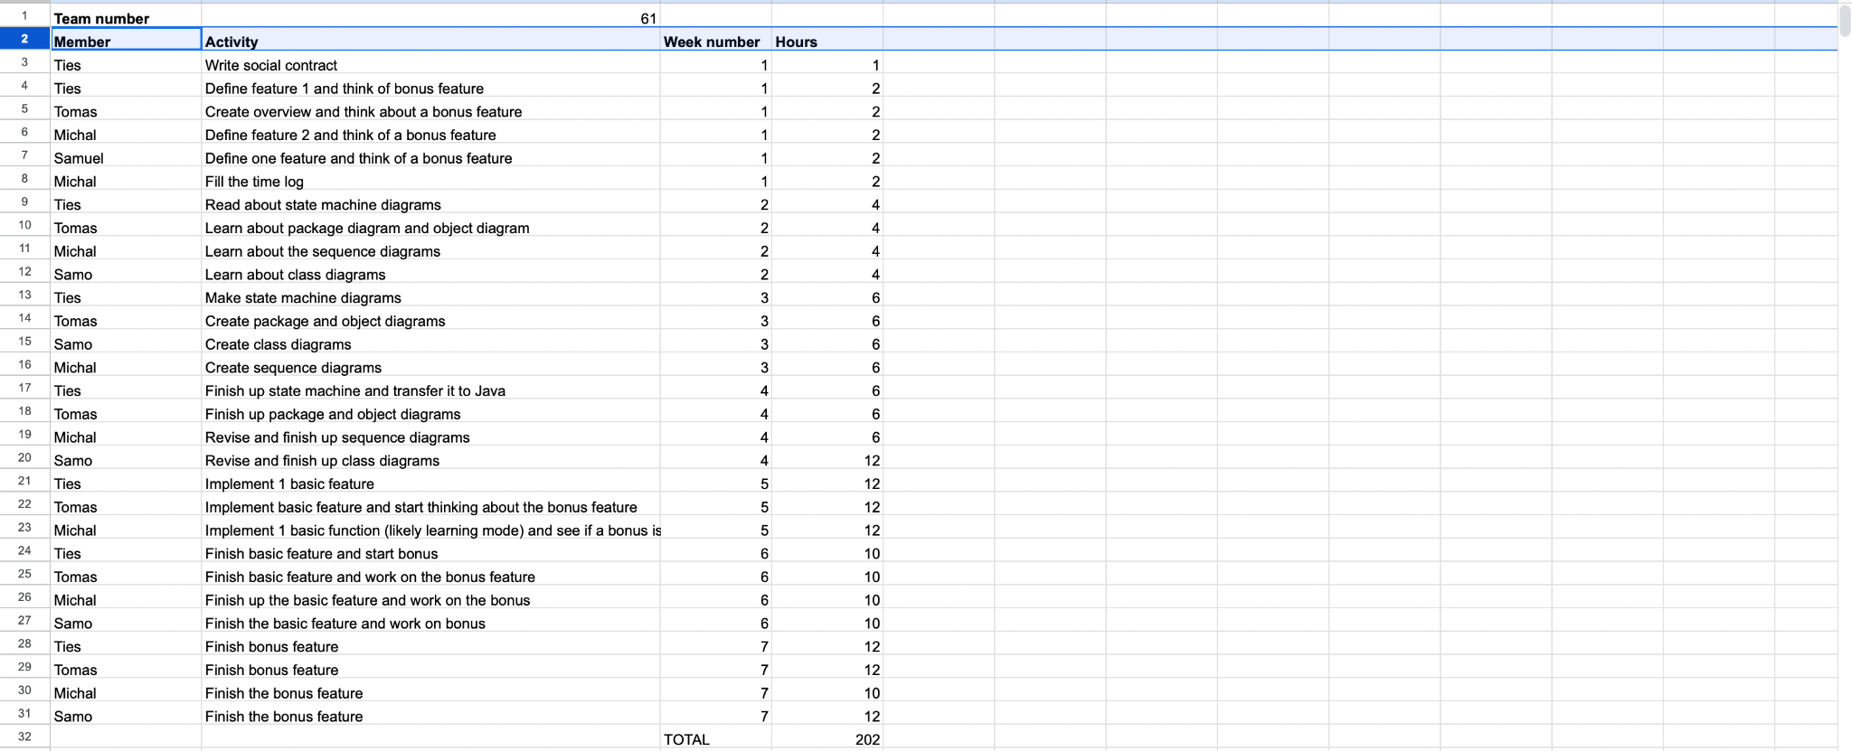
Time log

Slide 14
Signed contract
https://drive.google.com/file/d/11L2WrSTseyiwrUn4nfHnybbEogM4yPUE/view?usp=sharing

